Slide 1

Risk Assessment
NIST Special Publication 800-30

Slide 2


INFORMATION ASSURANCE PRESENTATION
MUHAMMAD SAAD
S2024408023
MUHAMMAD TALHA
F2021408057
MRS. NOUSHEEN MANZOOR
MIAN MUHAMMAD BILAL
F2021408054
TEACHER | BSCY -21

Slide 3

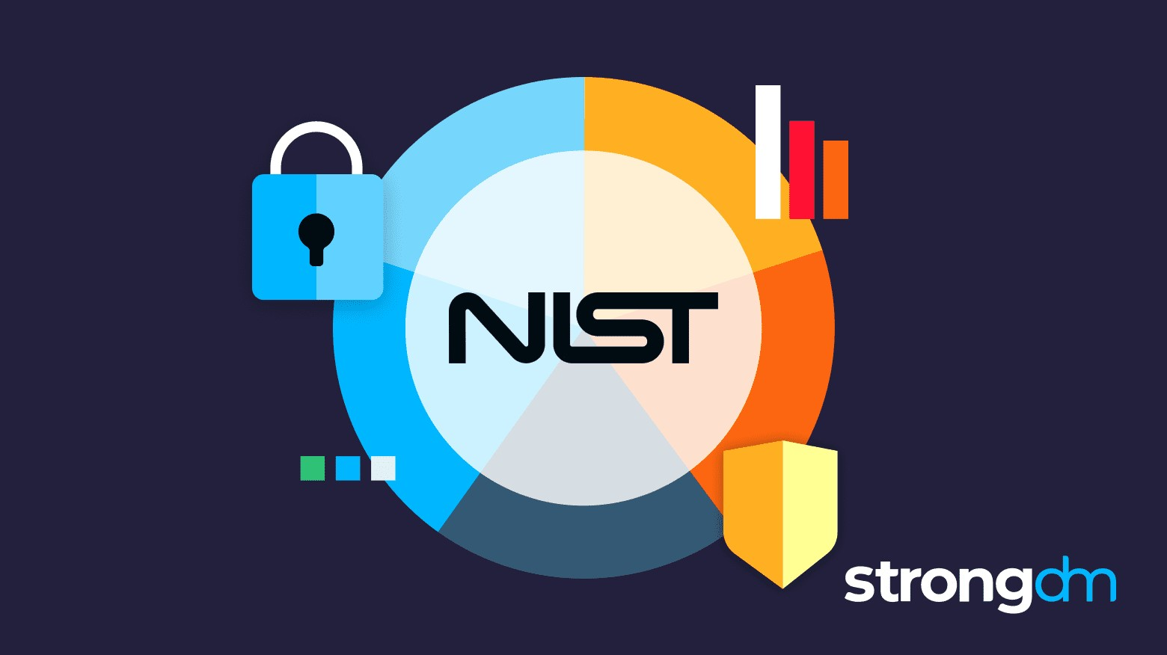

WHAT IS RISK? WHAT IS SECURITY ? WHAT IS RISK ASSESSMENT ?

Slide 4

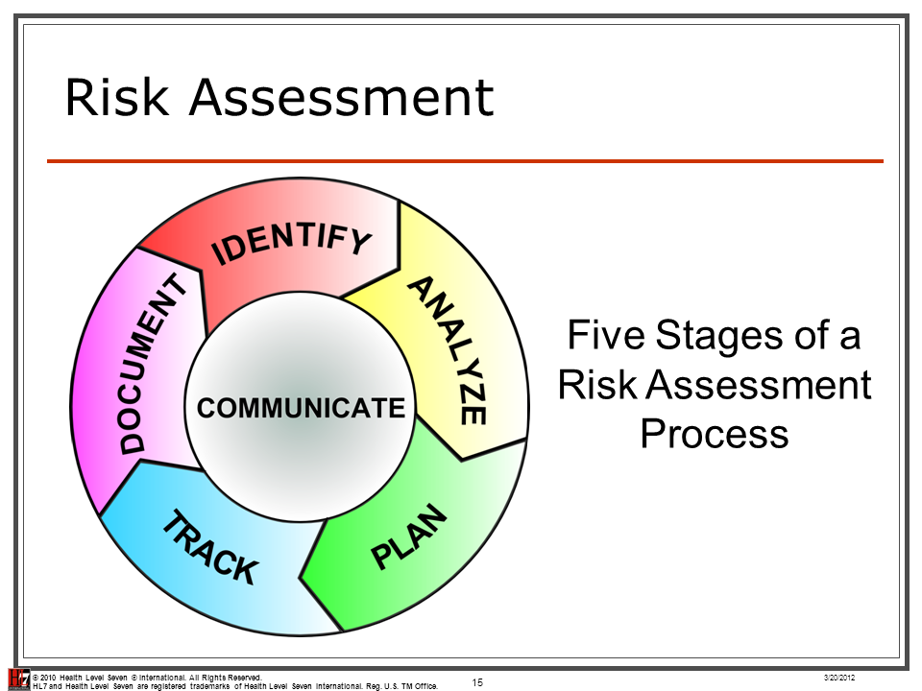
Risk assessment is not about eliminating risk, but about understanding it, managing it, and making informed decisions in its presence."

Slide 5
importance of risk assessments in information security

Slide 6
INTRODUCTION TO NATIONAL INSTITUTE OF STANDARDS AND TECHNOLOGY
ESTABLISHMENT
MISSION
CYBER SECURITY STANDARDS
NIST CYBER SECURITY FRAME WORK
GLOBAL INFLUENCE
SPECIAL PUBLICATIONS
COLLABARATION AND CONSULTAION
CONTINIOUS IMPROVEMENT

Slide 7
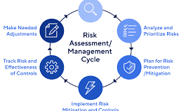
Purpose of NIST SP 800-30
WHY WE NEED THIS
Purpose of the document: to provide guidance on conducting risk assessments for information systems
Importance of risk assessments in identifying, assessing, and mitigating risks to information assets
Alignment with best practices and standards in cybersecurity

Slide 8
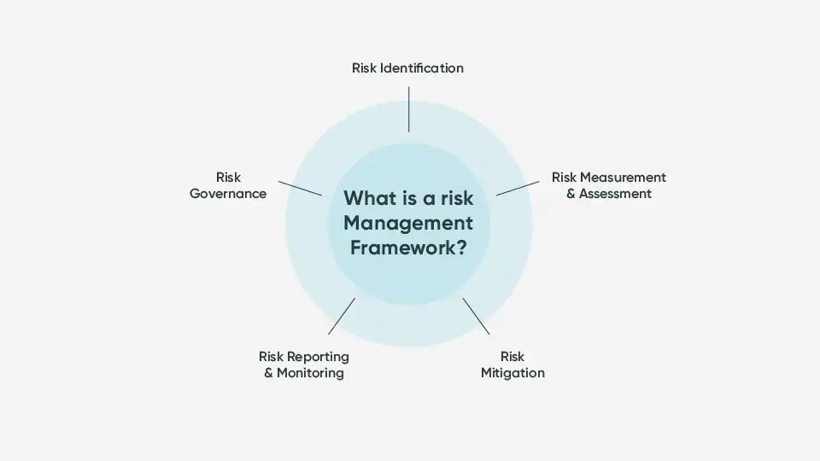
Definition of risk assessment
Components of the risk management process:
Preparation
Assessment
Analysis
Mitigation
Emphasis on a systematic and structured approach to risk assessment

Slide 9
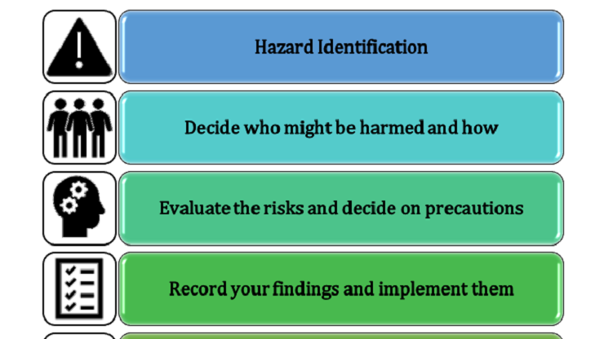
Risk Assessment Preparation
Steps involved in preparing for a risk assessment: establishing context, identifying stakeholders, defining risk criteria, etc.
Importance of understanding organizational goals and objectives.
Gathering necessary resources and documentation for the assessment process

Slide 10

Methods and techniques Documentation Consideration of potential impacts likelihood of risks
Conducting the Risk Assessment

Slide 11
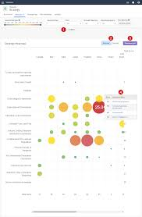
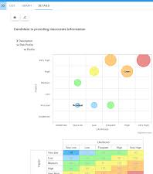
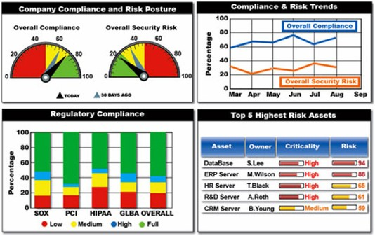
Analyzing Results
Evaluation of risk findings
Calculation of risk levels
Identification of high-risk

Slide 12

Implementing Risk Mitigation Strategies
Development of risk mitigation plans to address identified risks
Selection and implementation of appropriate controls and safeguards
Monitoring and reassessment of risks over time

Slide 13

Integration with Overall Risk Management
Integration of risk assessments into broader organizational risk management processes
Collaboration with stakeholders to ensure alignment with business objectives
Continuous improvement and refinement of risk management practices

Slide 14

Conclusion
Recap of key points covered in the presentation
Importance of ongoing risk management efforts in maintaining information security
Encouragement for organizations to utilize NIST SP 800-30 as a valuable resource in their risk management practices

Slide 15


Slide 16


